Slide 1
PS.3a
Scientists Who
Discovered What
The Atom is Like

Slide 2
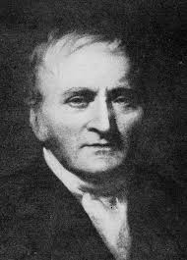
Dalton—1808
-atom is a rigid sphere
-cannot be divided

Slide 3
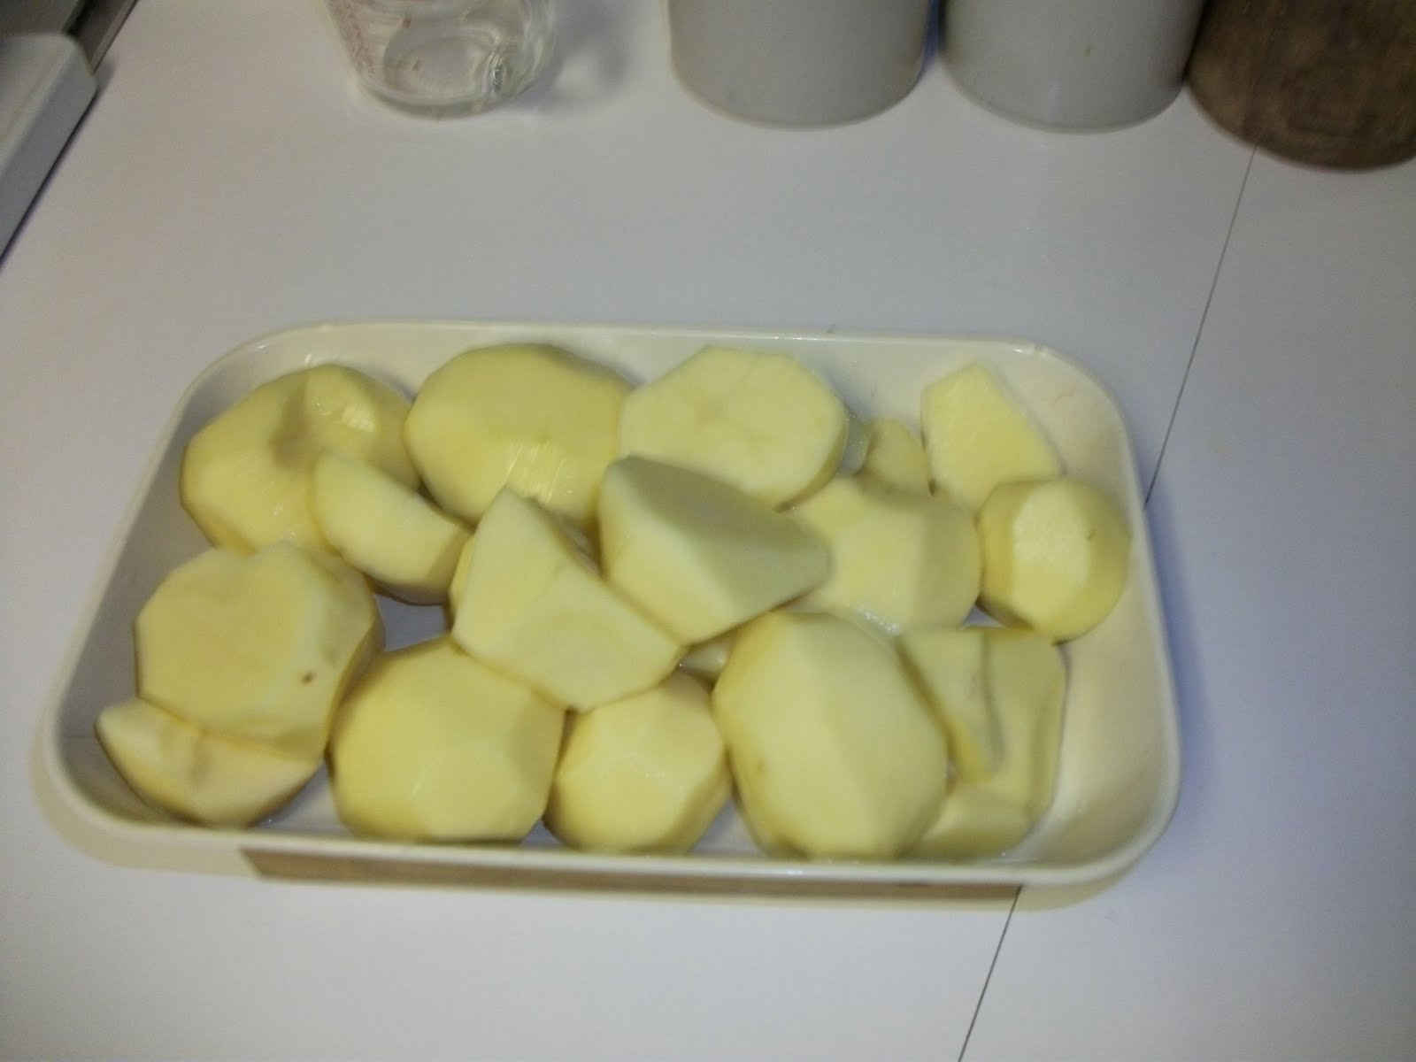

Slide 4
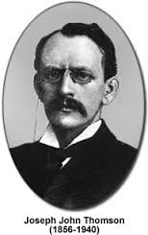
Dalton—1808
-atom is a rigid sphere
-cannot be divided
Thomson--1897
-discovered electron
-atom is solid ball of
++ charge with electrons
sprinkled through it

Slide 5
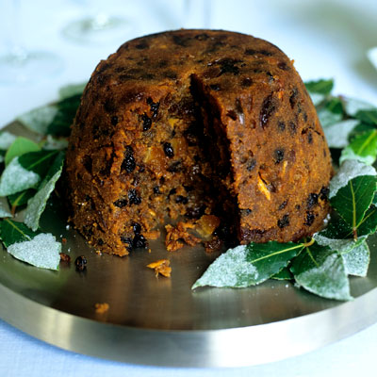

Slide 6
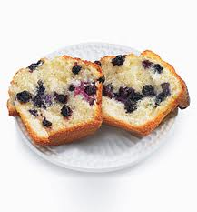

Slide 7
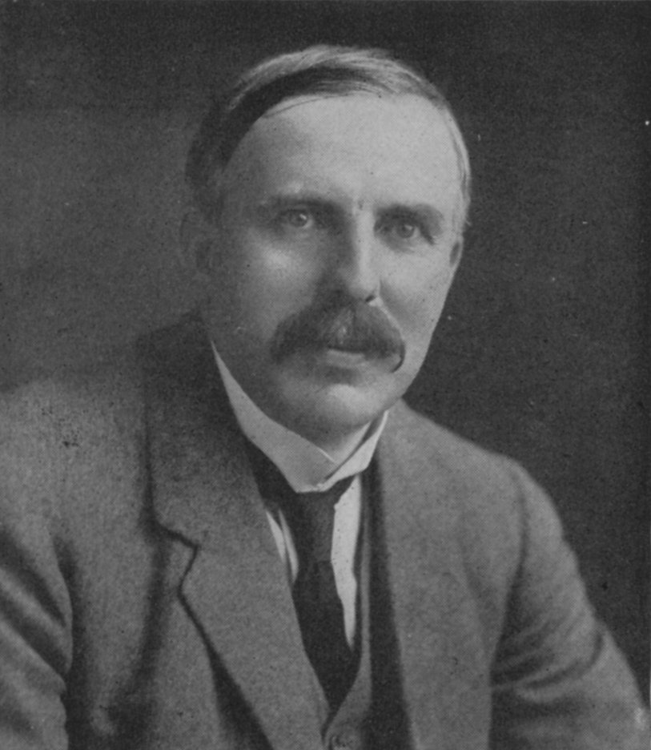
Rutherford—1911
-discovered proton
-concluded that the atom has
small positive nucleus
- could not conclude about what
the electrons were doing

Slide 8
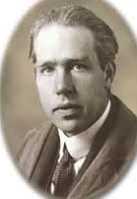
Bohr—1913
- agreed that the atom
has a nucleus
-theorized that electrons move in
layers called shells
-theorized that electrons can move
between shells

Slide 9
Chadwick discovered the neutron in 1936.

Slide 10
Chadwick discovered the neutron in 1936.
Modern Model of the atom
-atom has a nucleus
-We can only guess
where an electron is
at any time; so we draw
an “electron cloud” around
the nucleus.

